Slide 1
Virtual-reality-based cognitive behavioural therapy versus waiting list control for paranoid ideation and social avoidance in patients with psychotic disorders: a single-blind randomised controlled trial
Journal：Lancet Psychiatry
Impact factor：18.329

Slide 2
Introduction
1. People with psychotic disorders（精神障碍）often avoid public and social activities.
2. As many as 90% of patients with psychotic disorders have paranoid ideation （妄想错觉）to some degree, which are characterised by unfounded anticipation of intentional harm inflicted by other people.
3. This conditioned avoidance is not always affected by use of antipsychotic medication.
4. Cognitive behavioural therapy (CBT) is the most effective psychological treatment for people with psychotic disorders.
5. The effect sizes of CBT on paranoid delusions and social functioning can be improved by person-specific exposure.

Slide 3
Introduction
6. Limitations of exposure-based therapeutic exercises for paranoid ideation
(1) Social environment and reactions of others cannot be controlled by the therapist.
(2) Therapist feedback is retrospective and based on patient reports, which could be inaccurate because of biases
(3) Many patients are reluctant or unable to undergo exposure.
7. Virtual-reality-based CBT(VR-CBT) could overcome these limitations.
8. Two hypothesis:
(1) VR-CBT would lead to more time spent with other people, and a decrease in momentary paranoia.
(2) Safety behaviours and paranoid ideation would be reduced by VR-CBT.

Slide 4
Methods
1. Participants
(1) 58 to the VR-CBT group .
(2) 58 to the waiting list control group(treatment as usual).
(3) Inclusion criteria
(a) Paranoid Thoughts Scale>40
(b) 18<= age <=65
(4) Exclusion criteria
(a) IQ<=70
(b) Insufficient mastery of the Dutch language
(c) History of epilepsy（癫痫）

Slide 5
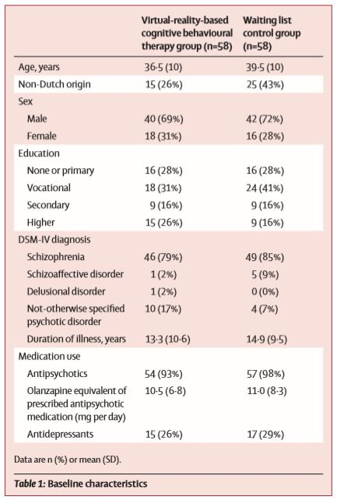
Methods

Slide 6
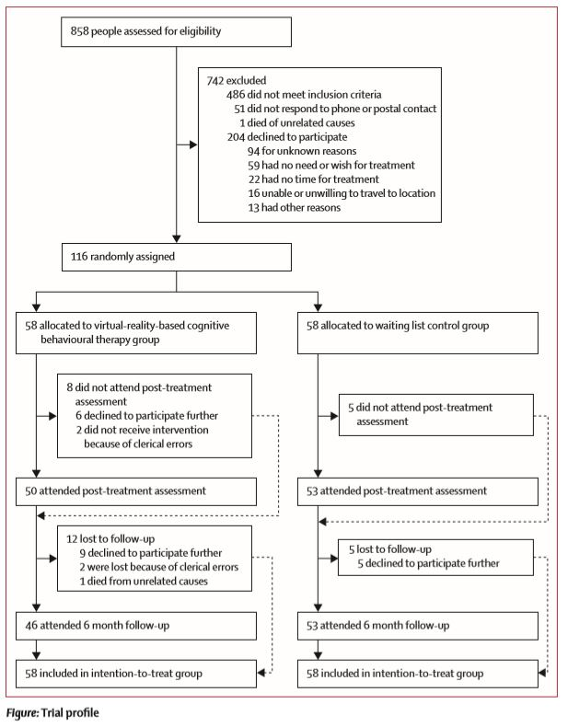
Methods

Slide 7
Methods
2. The VR-CBT
(1) 16 sessions over 8–12 weeks, 1 h/session(40 min of which comprised virtual reality exercises. The remaining 20 min were used to plan and reflect on exercises).
(2) Four virtual social environments (a street, bus, café, and supermarket) were created with Vizard software.
(3) Move by operating a Logitech F310 Gamepad, using a Sony HMZ-T1/T2/T3 Head Mounted Display and a 3DOF tracker for head rotation.
(4) Therapists vary the characteristics of the avatars (including sex and ethnicity), and the avatars’ responses to the patient (neutral or hostile, eye contact) to match the paranoid fears of the patient.

Slide 8
Methods
2. The VR-CBT（续）
(5) Therapists could also make the avatars say pre-recorded sentences. Because these stimuli were directly controlled by the therapist, personalised treatment exercises were created for each patient.
(2) Patients and therapists communicated during virtual-reality sessions to explore and challenge suspicious thoughts during social situations, drop safety behaviours during social situations.
(3) Details of the study protocol have been published(Trails, 2016)

Slide 9
Outcomes
1. Social participation(Using The experience sampling method and Likert scale)
(1) Amount of time spent with others
(2) Momentary paranoia
(3) Perceived social threat
(4) Momentary anxiety in company
2. Symptom
(1) Safety Behaviour Questionnaire-Persecutory Delusions
(2) Paranoid Thoughts Scale
(3) Social Interaction Anxiety Scale
(4) Beck Depression Inventory

Slide 10
Outcomes
3. Functional outcomes
(1) Social and Occupational Functioning Assessment Scale
(2) Manchester Short Assessment of Quality of Life
(3) Internalized Stigma of Mental Illness questionnaire
4. Working mechanisms of the therapy
(1) Brief Core Schema Scales
(2) Davos Assessment of Cognitive Biases Scale
(3) Brief Adherence Rating Scale

Slide 11
Results
1. Amount of time spent with others marginally increased by 0.3% in the VR-CBT group.
2. A large reduction was noted in momentary paranoia (-0.350) in the VR-CBT group.
3. A significantly larger decrease in momentary anxiety was noted in the VR-CBT group.
4. The effect sizes for momentary paranoia and anxiety remained significant at follow-up.
5. Individuals who received VR-CBT used less safety behaviour and reported fewer social cognition problems.
6. VR-CBT group had improvements in self-stigmatisation and social functioning.

Slide 12
Results
7. Individuals who received VR-CBT used less safety behaviour and reported fewer social cognition problems.
8. Mediation analysis showed that part of the treatment effect on paranoid ideation at the post-treatment assessment was mediated by change in safety behaviour (33.7%) and change in social cognitive problems (19.2%).

Slide 13
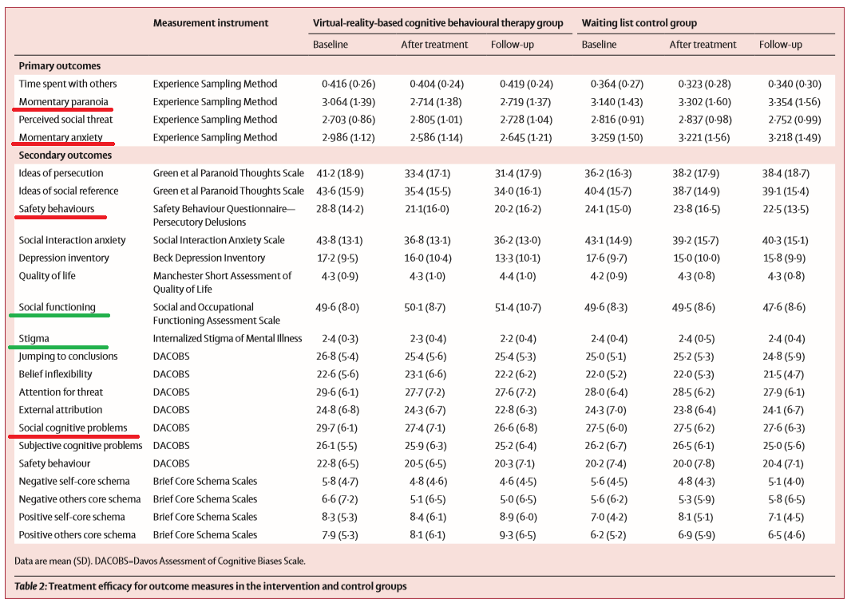

Slide 14
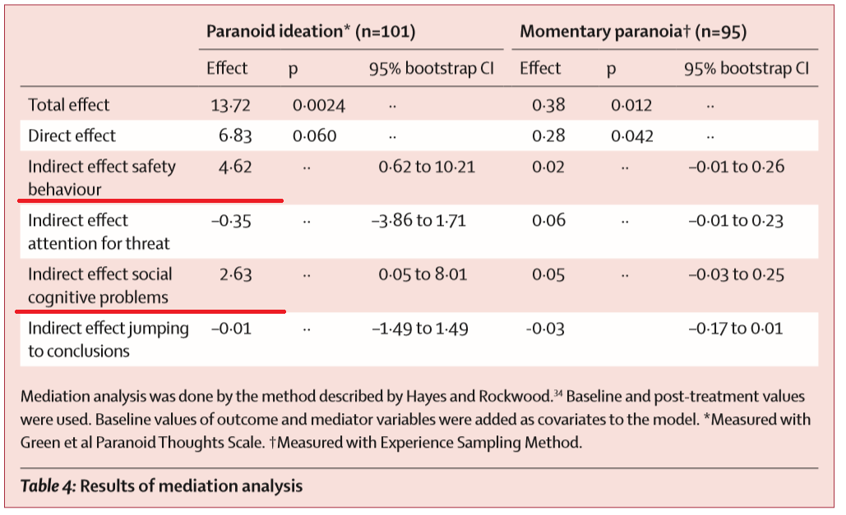

Slide 15
Conclusion
1. Ours is the first randomised controlled trial of VR-CBT to treat paranoid ideation and social avoidance in patients with psychotic disorders.
8. Our findings support the hypothesis that VR-CBT strongly reduces paranoid ideation, momentary anxiety, and safety behaviours in real-life social situations.

Slide 16
Limitations
1. We did not use an active control group, such as CBT with exposure in vivo.
2. The long-term effects of VR-CBT remain unknown,.
3. Technological limitations restricted conversational interaction possibilities between participants and avatars.
4. Patients are not exposed to unexpected surprises that can occur in life.
5. Some eligible patients did not participate because they were too frightened to travel to the therapy location. Thus our sample might have been biased.
6. The temporal order of the mediation analysis was based on the assumed mechanisms of VR-CBT, but reverse causality cannot be ruled out.

Slide 17
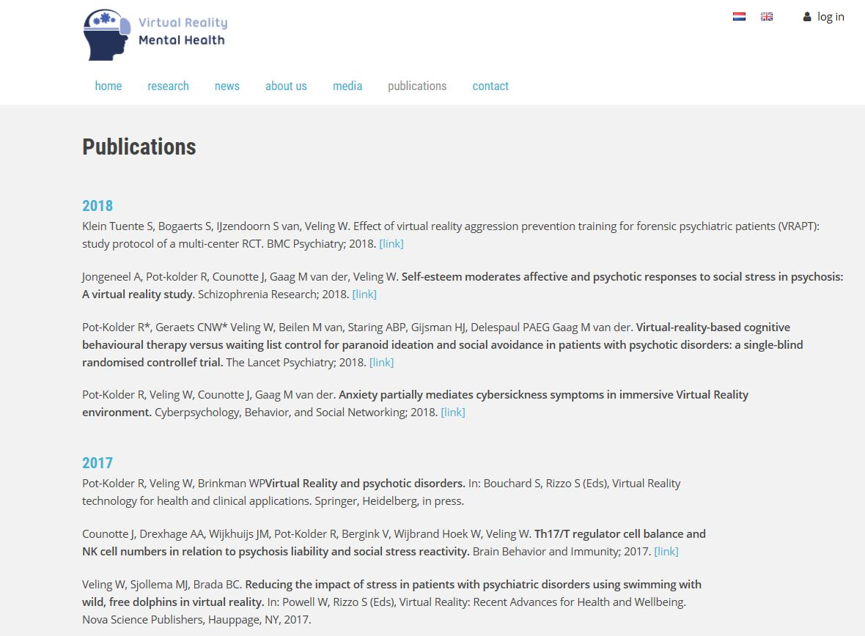
www.vrmentalhealth.nl/en

